Slide 1
The C Programming
Xiaoya FAN 范晓娅
xiaoyafan@dlut.edu.cn

Slide 2
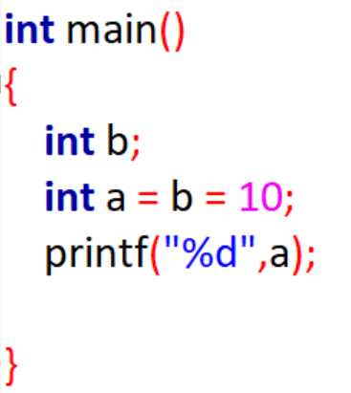
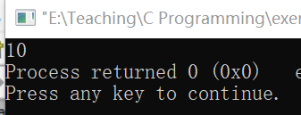
Single Select
1.Which one is wrong?
int a,b;
a=10;
b=10；
int a,b;
a = b = 10;
int a = 10, b = 10;
int a=b=10;
D
3. a and b are double variables, a=5.5，b=2.5, what is the value of expression:（int）a+b/b ?
6.500000
6
6.000000
5.500000
2. Which of the following is illegal:
n = ++i；
j++;
x = (j--);
++(i+1);
C
D

Slide 3
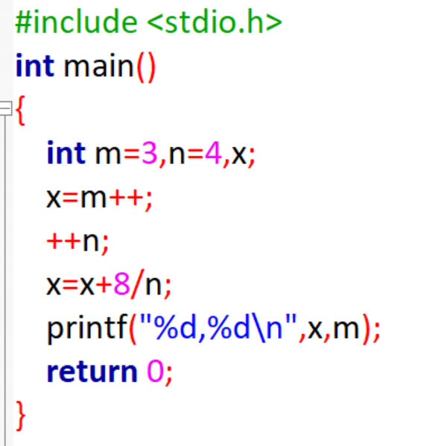
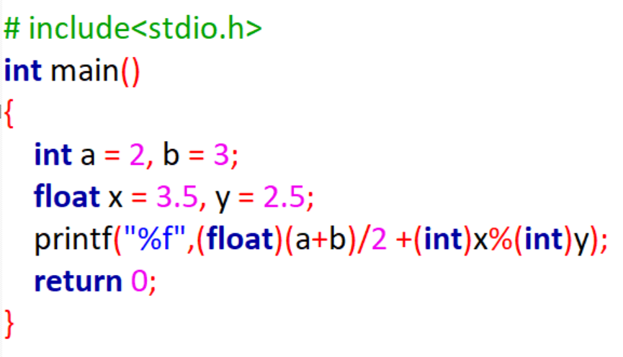

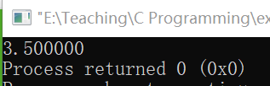
What the output will be?
m = 4
x = 3;
n = 5
x = 3 + 1 = 4
3

Slide 4
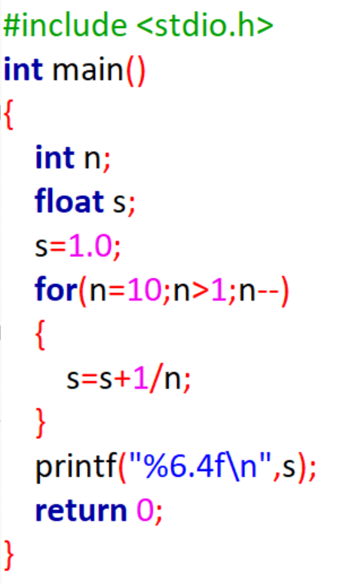
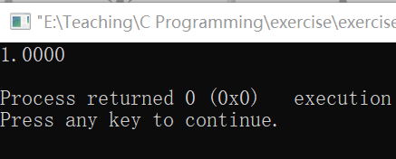

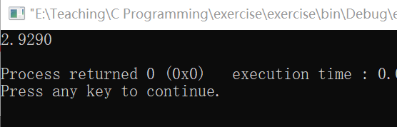
Calculate s=1+1/2+1/3+…+1/10;
Anything wrong?
4

Slide 5
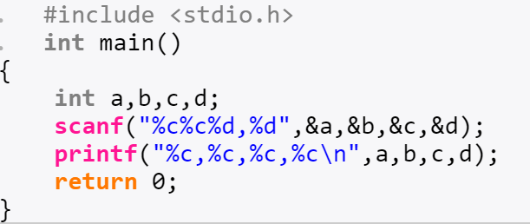
Single Select
1.Which one can represent a legal const character?
68
‘\010’
D
“B”
2. Run the above code and input from keyboard：6565,66<enter>
The output will be:
6,5,6,5
6,5,A,B
6,5,65,66
6,5,6,6
B
B
5

Slide 6
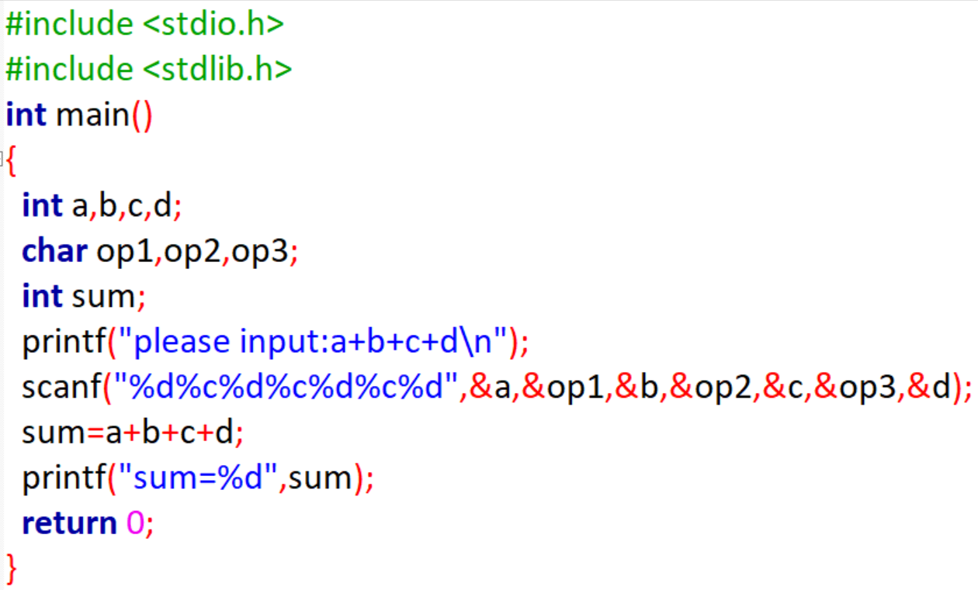
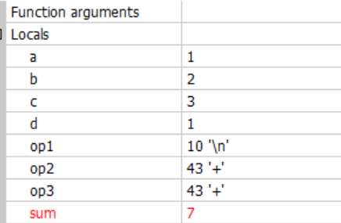
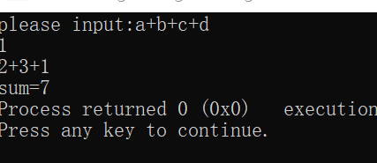
What the output will be?
Input from keyboard:
1 （enter）
2+3+1 (enter)
6

Slide 7
Single Select
There is a declaration: int (*p)(), which one is right?
p is a pointer variable that points to a 1D array
p is a pointer variable that points to an integer
p is a pointer variable that points to a function
that returns an integer
None of the above is right
C
7

Slide 8
Single Select
The declaration: int *f() means:
a pointer variable that points to a function
a pointer that points to a row of a 2D array
C. a function that returns a pointer
D. a pointer variable that points to an integer
C
8

Slide 9
Single Select
Which one is wrong?
A pointer variable can only points to variables of one data type
The number of bytes a pointer variable occupies equals to the number of bytes that the variable it points to occupies.
A pointer variable has to be initialized before use. If not, the result will be unknown. It can be initialized as NULL.
B
9

Slide 10
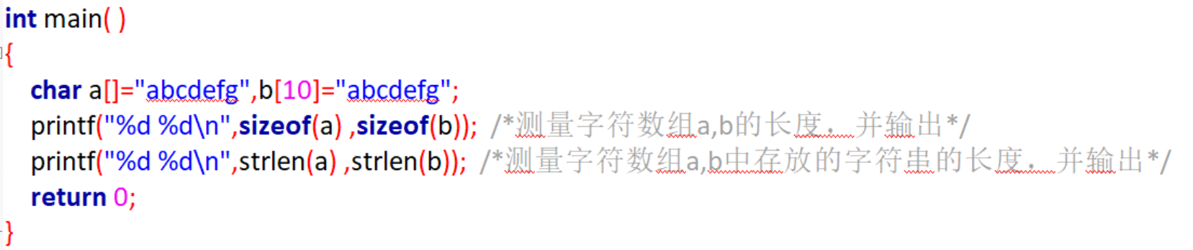
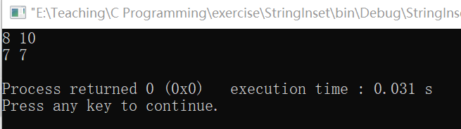
Single Select
Given the definition as follows，which one is correct?
Char x[] = “abcdefg”;
Char y[] = {‘a’,’b’,’c’,’d’,’e’,’f’,’g’};
Array x and y has equal length
Array x has longer length than array y
Array x has shorter length than array y
Array x and array y is equal
B
10

Slide 11
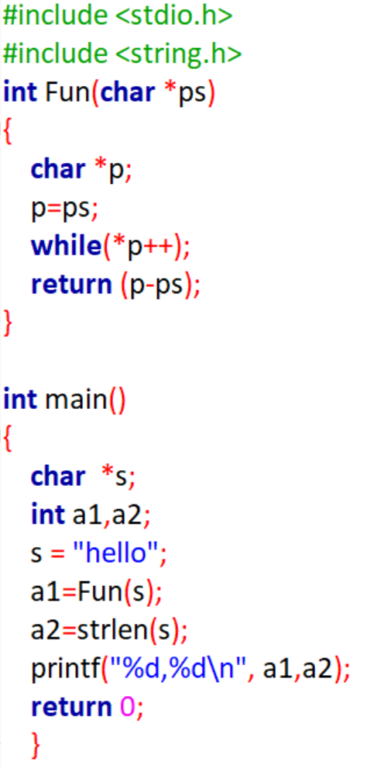
What does the subfunction Fun do?
Compare two string
Copy string ps to string s
Give the length of the string
D. None is correct
C
11

Slide 12
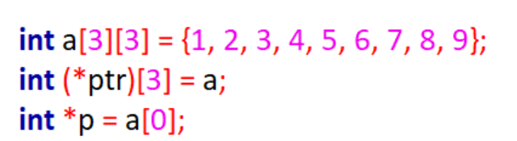
Single Select
ptr: 数组指针，指向数组，+1跳过一行
*(ptr) *(ptr+1) *(ptr+2）
Which one represents the value of a[1][2] ?
*(*(ptr + 1) + 2)
*((*ptr + 1) + 2)
*(*(p + 5))
(*ptr + 1) + 2
a[0][0]: 1
a[0][1]: 2
a[0][2]: 3
a[1][0]: 4
a[1][1]: 5
a[1][2]: 6
a[2][0]: 7
a[2][1]: 8
a[2][2]: 9
ptr
ptr+1
*（ptr+1）
p + 5
*（ptr+1）+2
The key to pointer: base type
ptr+2
12

Slide 13
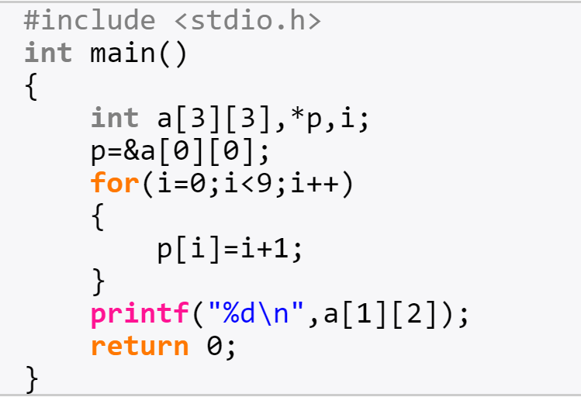
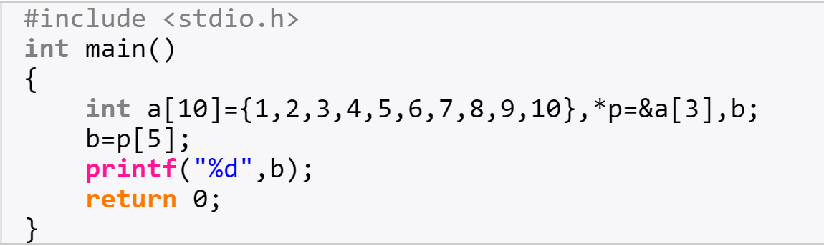
What the output will be?
6
9
13

Slide 14
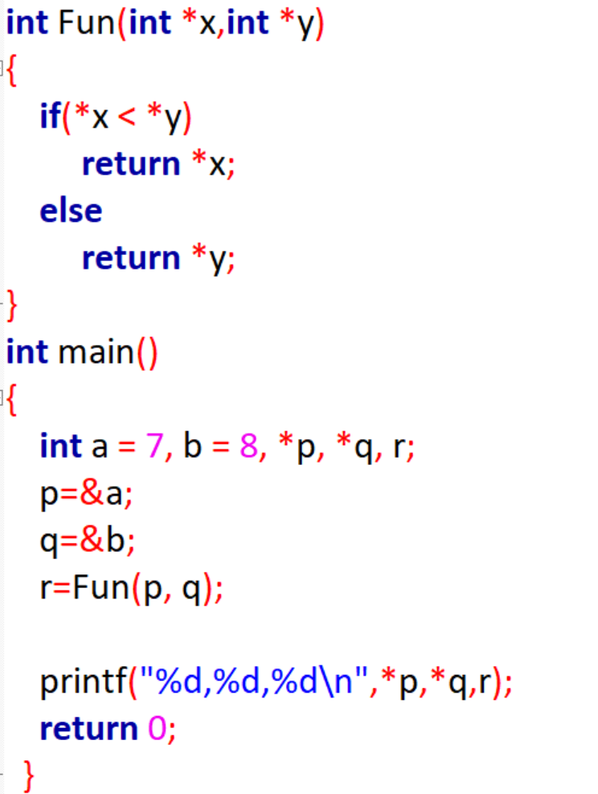
The subfunction Fun receives two pointers point to integer and returns the minimal value of the contents they point to.
14

Slide 15
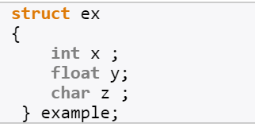
Given the code above, which of the following is wrong
x,y,z are members of the struct;
example is a type name of struct;
struct is keyword for struct
ex is the label of struct
B

Slide 16
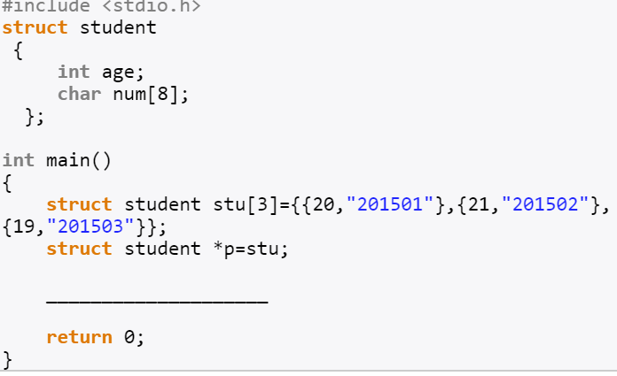
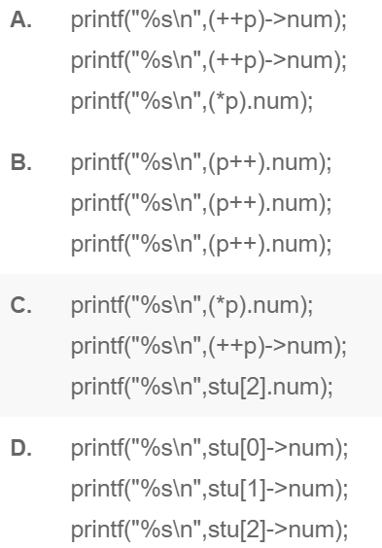
The output is:
201501
201502
201503
Choose the right sentences to fill in.

Slide 17
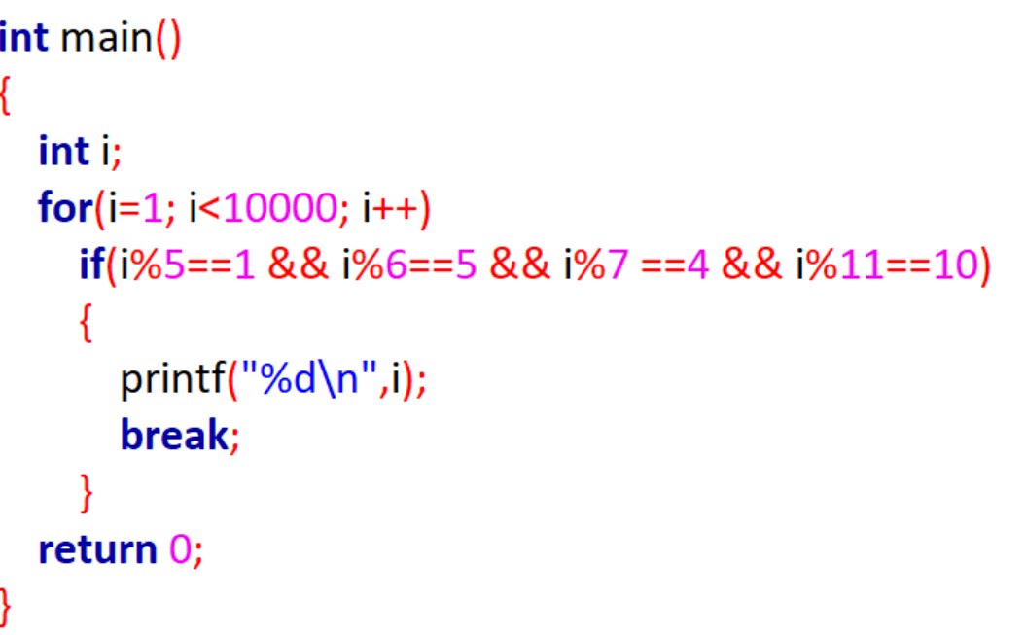
程序填空（韩信点兵）
韩信有一队兵，按从1至5报数，最末一个士兵报的数为1,；按从1到6报数，最后一个士兵报的数为5；按从1到7报数，最后一个士兵报数为4；按从1到11报数，最后一个士兵报的数为10，请问韩信至少有多少兵？
17

Slide 18
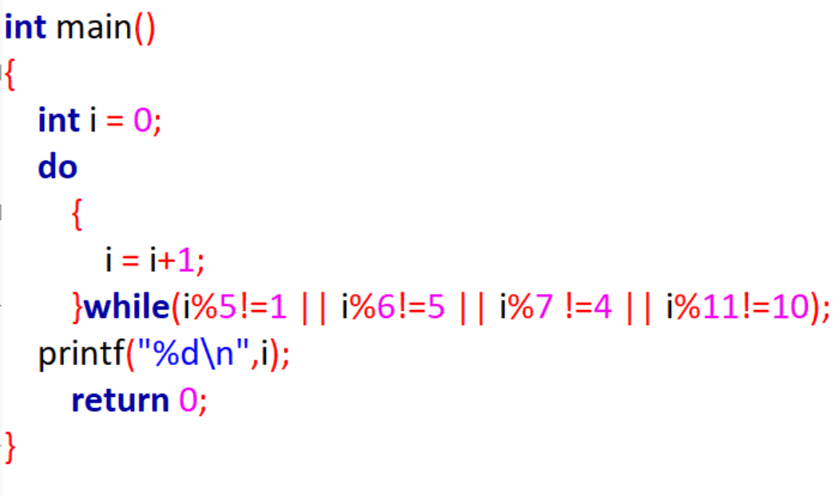
程序填空（韩信点兵）
韩信有一队兵，按从1至5报数，最末一个士兵报的数为1,；按从1到6报数，最后一个士兵报的数为5；按从1到7报数，最后一个士兵报数为4；按从1到11报数，最后一个士兵报的数为10，请问韩信至少有多少兵？
18

Slide 19
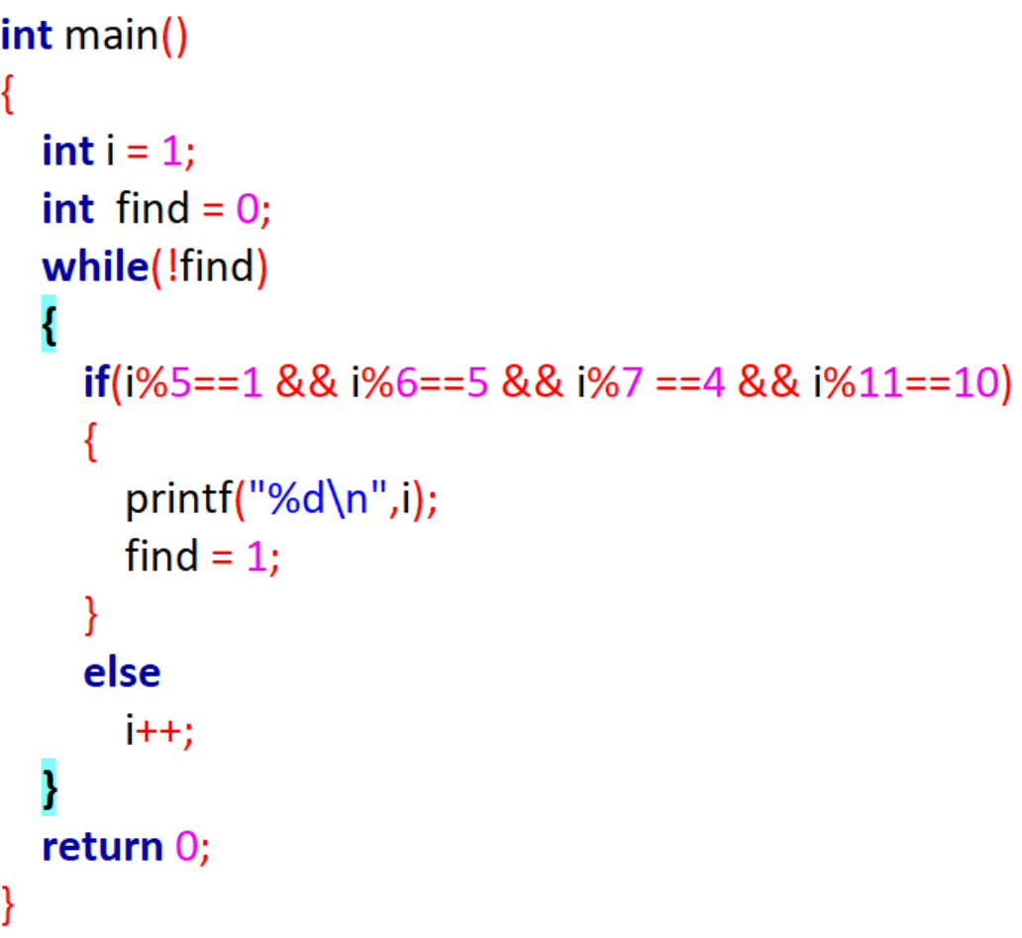
程序填空（韩信点兵）
韩信有一队兵，按从1至5报数，最末一个士兵报的数为1,；按从1到6报数，最后一个士兵报的数为5；按从1到7报数，最后一个士兵报数为4；按从1到11报数，最后一个士兵报的数为10，请问韩信至少有多少兵？
19

Slide 20
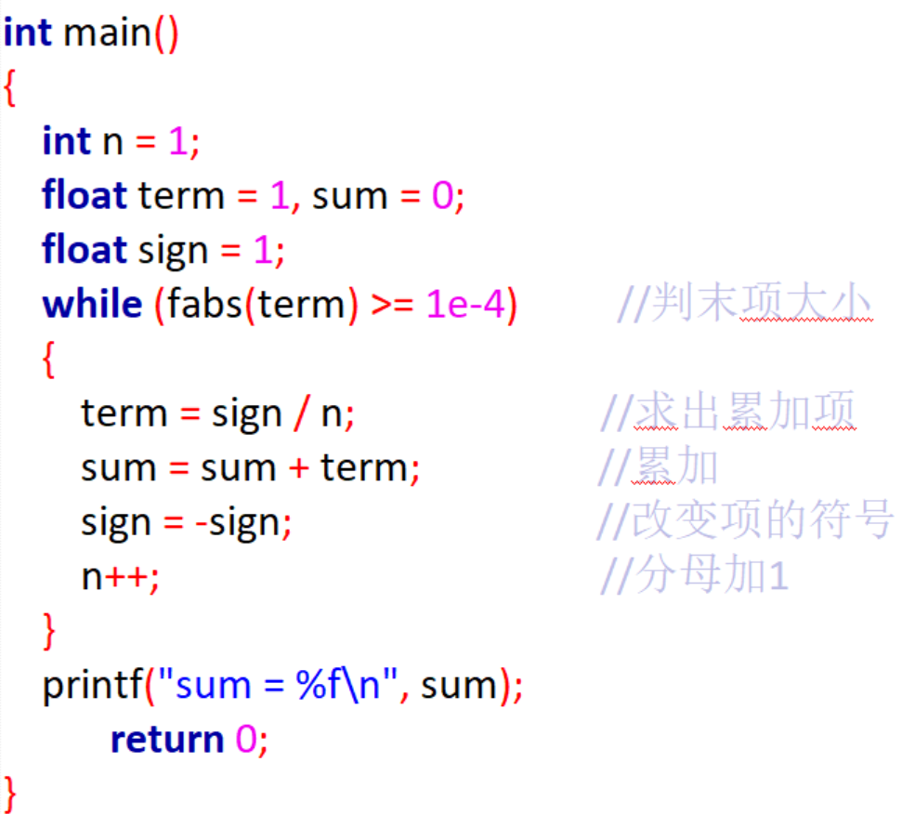
Calculate 1-1/2+1/3-1/4+…+1/99-1/100+…
Until the absolute value of the last term is smaller than 10e-4
20

Slide 21
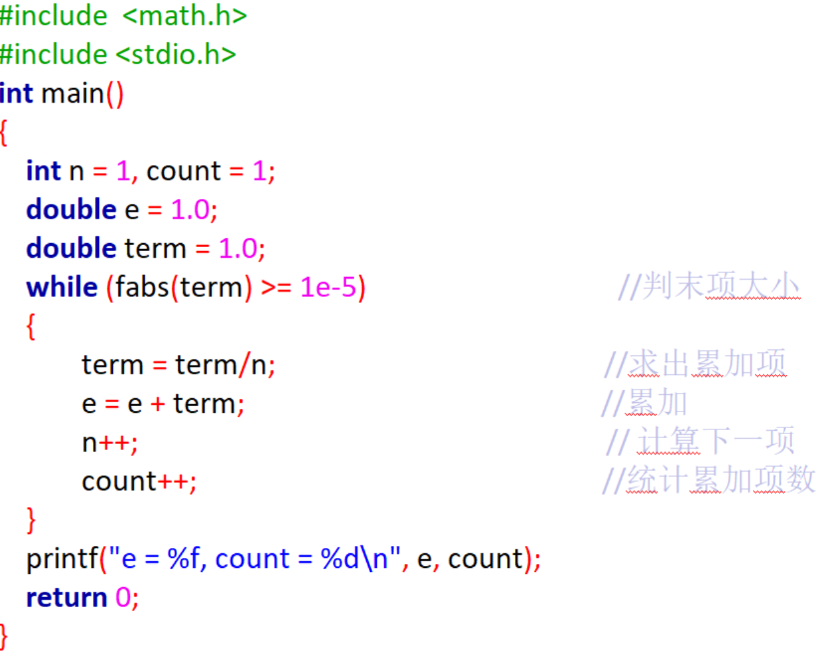
Calculate e = 1 + 1/1！+ 1/2！+ 1/3！+ 1/n!…
Until the absolute value of the last term is smaller than10e-5，please count the number of terms (n)
21

Slide 22
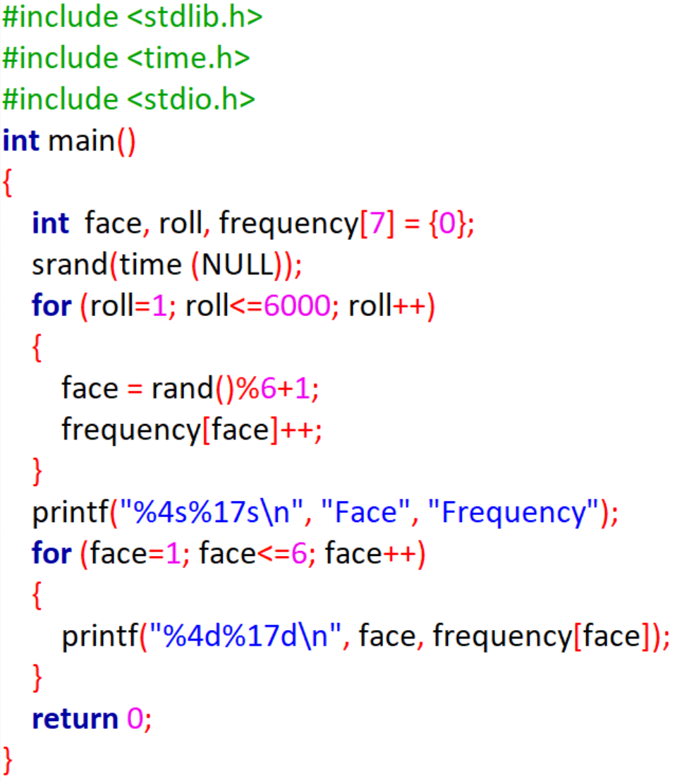
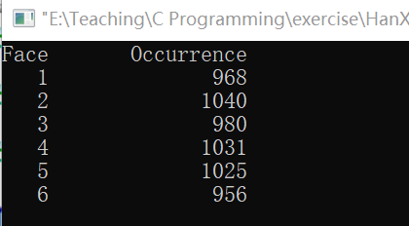
Throw the dice for 6000 times, count the occurrence of each face and output results as follows:
22

Slide 23
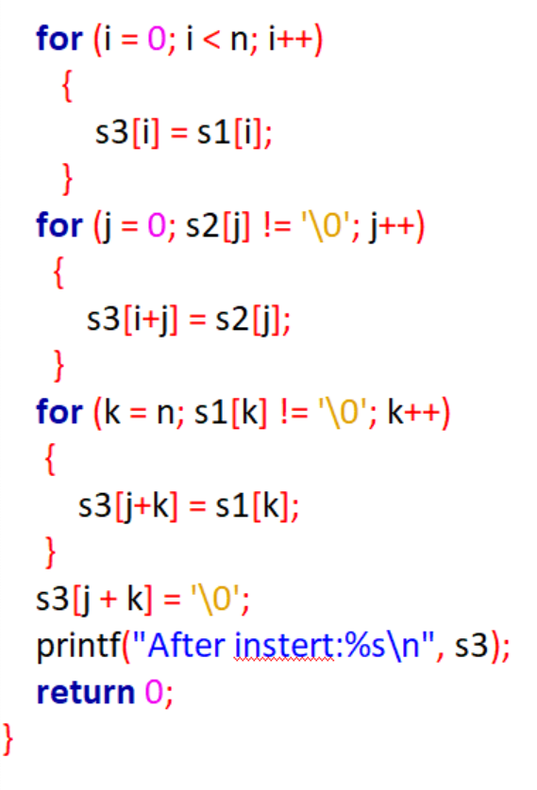
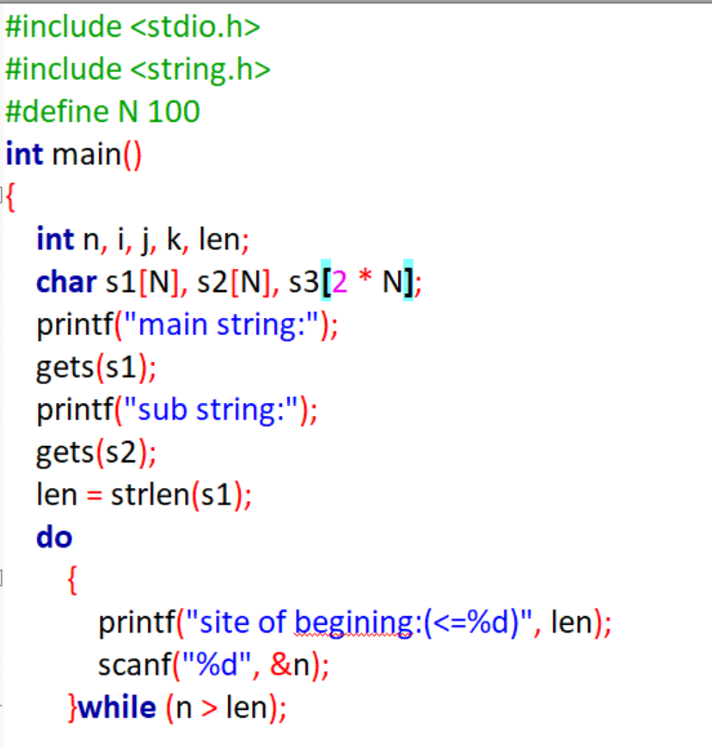
Insert the string s2 to string s1, at position n
23

Slide 24


Generate a random array a[N], sort it in descending order, then randomize it.
Generate an array
Sort
Randomize
怎么设计程序？
24

Slide 25

Generate a random array a[N], sort it in descending order, then randomize it.
25

